Slide 1

Session 1
SHE Strategies

Slide 2

View from the regulator
Elaine Harbour
Director of Health & Safety

Slide 3
Working in different jurisdictions
It’s the same but different
Risks essentially the same
System maturity
HSE v HSI
Identical training & operating model
No LA enforcement
strict disclosure rules

Slide 4
General Observations
Regulatory benchmarks
Industry standards
Section 3 Article 5
Occupational health
Social media

Slide 5
Learning from major incidents
Impact on community
Incident response & recovery
Wider impact
Preparedness
Joint working opportunities & challenges
Better understanding of roles

Slide 6

Thank you

Slide 7
The Significance of Health and Safety Strategy in the Electricity Networks Sector
Cordi O’Hara
  6th June 2024

Slide 8
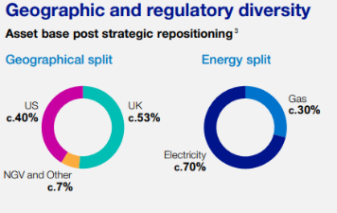
An Introduction to National Grid Group
Electricity Transmission
We own and maintain the high-voltage electricity transmission network in England and Wales.
Electricity Distribution
We are the UK’s largest DNO and safely deliver electricity to over 8 million customers over a 55,500 square kilometres service area.
Strategic Infrastructure
We will deliver 17 major projects in the UK to achieve our net zero ambition and help meet the 50GW of renewable energy target by 2030.
New England
Across Massachusetts, we manage more than 11,000 miles of natural gas main and 18,000 circuit miles of overhead and underground lines, serving 1.3 million customers.
New York
We deliver both electricity and natural gas safely, reliably, and cost-effectively to our 4.1 million customers, across a 27,000 square mile service area.
NGV
We develop, operate and invest in energy projects, technologies and partnerships to accelerate the development of our clean energy future.
ESO
Every day we move over 730GWh of high-voltage electricity around the country. That’s enough to power 146 billion light bulbs!
ESO is becoming the National Energy System Operator (NESO), a new, independent, public corporation that will be responsible for planning Britain’s electricity and gas networks and operating the electricity system. The new organisation will be operational in summer 2024.

Slide 9
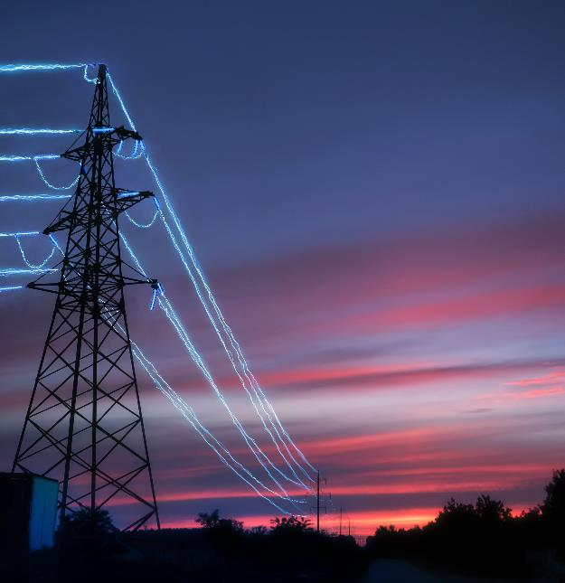
An Introduction to National Grid Electricity Distribution
National Grid Electricity Distribution (NGED) is the regional distribution division of National Grid, made up of both the Distribution Network Operator (DNO) and our functionally separate Distribution System Operator (DSO)
We are the UK’s largest distribution network, with a distribution area of 550,000 square kilometres.
Our network serves nearly 8 million customers in the East and West Midlands, South West and Wales, delivering essential power to homes and businesses across our regions.
We have 6,500 colleagues who are committed to providing a safe, stable and reliable electricity supply and ensuring the highest quality of customer service.
Our business is made up of the DSO, responsible for network planning, flexibility market development and real time operations, and the DNO which owns and maintains the network and delivers new connections.
Our strategy is to deliver outstanding operational performance for all our customers, meet the needs of our local stakeholders and support a sustainable energy future.

Slide 10
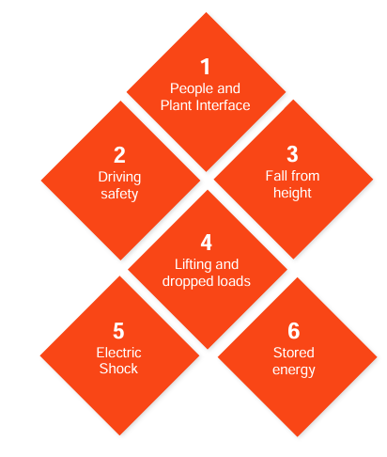
NGED Safety Focus
Safety Leadership
Safety Culture Maturity
Enhanced Safety Controls
Strategic safety leadership
Safety Culture Tone
Safety Management
Visible Safety Leadership
Safety at the Frontline
Crew leader mindset
Enterprise Safety Risks
Safety Investment
Fair Culture
Celebrate Safety
Safety coaching
Behaviours reinforced and corrected
Stand up for Safety
Safe Choices
Safe to
Say
Safe to Stop
Safe to Learn
Over that last 3yrs, 95% of our highest severity incidents have all occurred in these six categories.

Slide 11


Supporting Individuals Working Alone
Substation Inspections
Customer visits
Switching
Pole Testing
Travelling
Meter Reading
Line Patrol
Remote Locations
Meter Fixing
Current
Problem
The Opportunities
Policies
Risks Assessments
Procedures
Occupational Fatigue
Violence and Harassment
Road risks
Learn & Care culture
Innovation and Technology
Eliminate/ Reduce

Slide 12
Deepening Industry Strategy and Collaboration on Safety & Wellbeing
Our Collective efforts are required to enable net zero
Our people will be the driving force towards a successful transition.
Across our sector - The same themes underpins our safety risks and incidents.
Combining our efforts on H&S programs and innovations – key to zero harm.
Working effectively together to enable safe outcomes for all our people, delivery partners, and the public.

Slide 13
End

Slide 14
Brian Sinclair
January 2024
Head of Health and Safety for NIE Networks and Chair of the Powering Improvement Culture Sub-group.
Notes:
Introduction to my history and journey with NIE Networks
My Journey with Powering Improvement

Slide 15
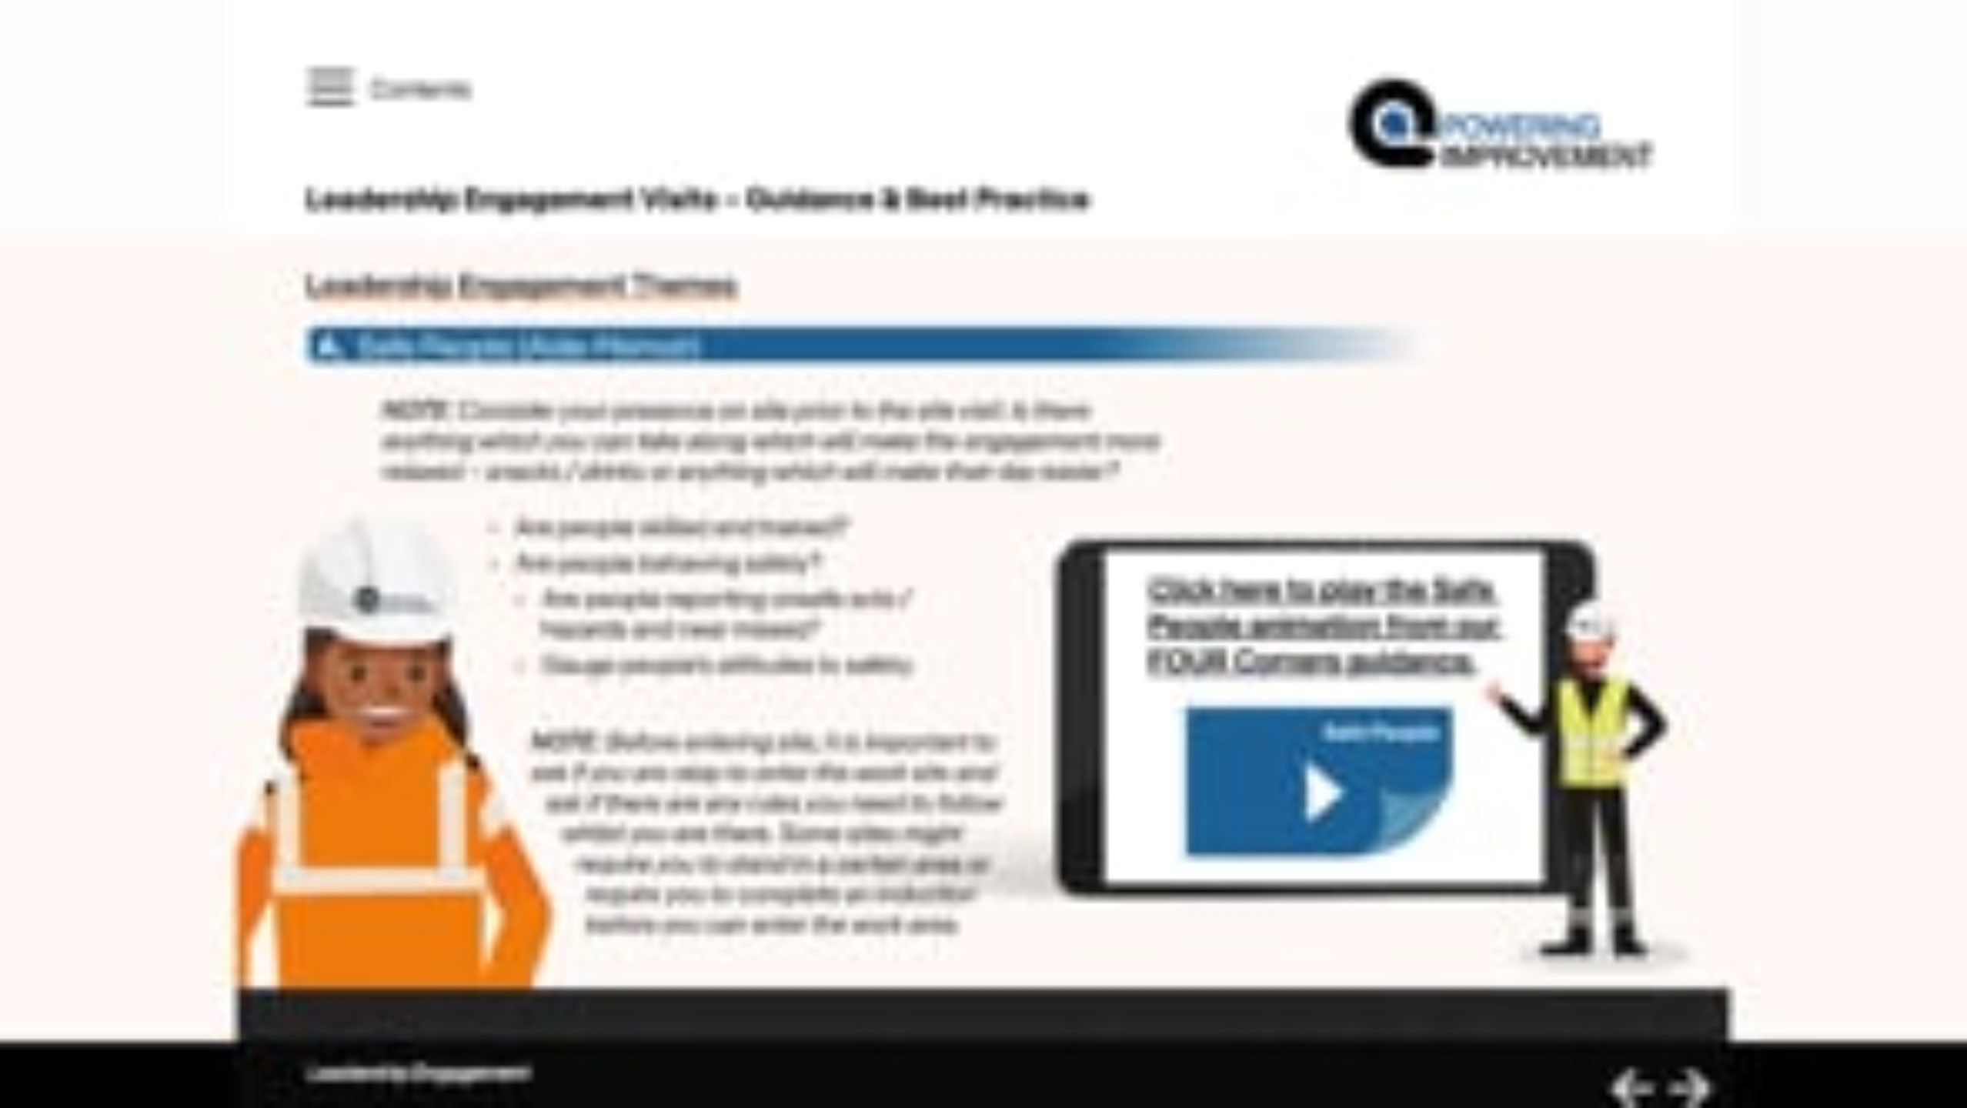
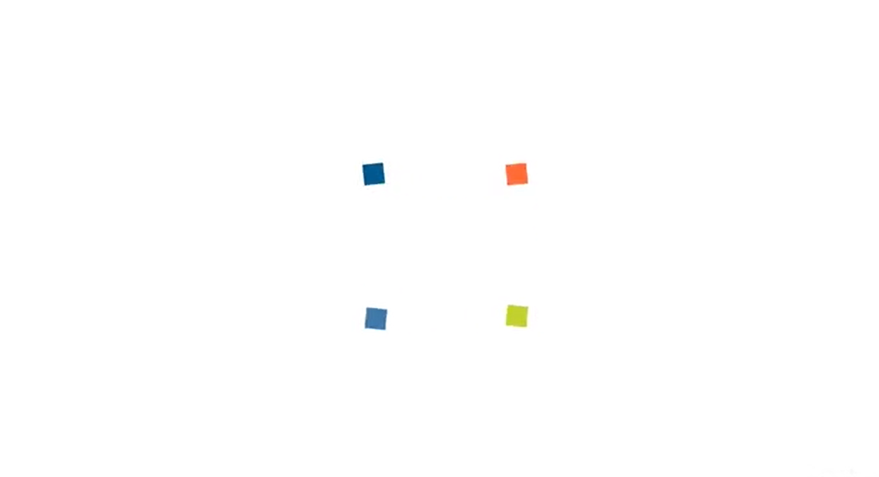
Safety Culture Guidance and Leadership Engagement Teaser

Slide 16
Thank you and we look forward to you joining us on the 27th June for our launch Webinar
Details will be communicated soon

Slide 17
Session 4
Future challenges

